Slide 1




Channabasaveshwara Institute of Technology (Affiliated to VTU, Belagavi & Approved by AICTE, New Delhi) ( NACC Accredited & ISO 9001:2015 certified institution) NH 206 (B H Road), Gubbi, Tumkur - 572216
Department of Computer Science and Engineering
2023-24
Internship Project Presentation
Carried out in
EUNOIA LABS
On
“ANEMIA PREDICTION USING MACHINE LEARNING ”
Presented by: Guided by:
SHEETHAL K S Mrs. Rashmi C R
1CG20CS092 Assistant professor
CIT, GUBBI Department of CSE
CIT, GUBBI

Slide 2
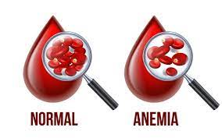
CONTENTS
Introduction
Problem statement
Objectives
Methodology
Result
Conclusion
Reference

Slide 3
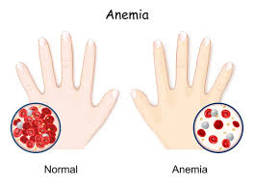
INTRODUCTION
Anemia, a condition characterized by a deficiency of red blood cells or hemoglobin in the blood, affects millions of people worldwide and can lead to serious health complications if left untreated.
Anemia arises from various factors, including nutritional deficiencies, chronic diseases, genetic disorders, and certain medications. It manifests through symptoms such as fatigue, weakness, shortness of breath, and pale skin.
Diagnosis often relies on blood tests to measure hemoglobin levels, red blood cell count, and related parameters.
Machine Learning offers promising accurate results, It is also helpful for the anemia prediction by analyzing diverse datasets.

Slide 4

PROBLEM STATEMENT
Traditionally, diagnosing anemia has relied on subjective assessment methods, necessitating the development of machine learning models to provide objective and accurate predictions based on diverse patient data, thereby enhancing early detection and intervention strategies for improved healthcare outcomes

Slide 5

OBJECTIVES
To develop a Anemia Prediction model using machine learning.
Comparison of different algorithms to find which algorithm is best for the dataset.

Slide 6

METHODOLOGY
Anemia Dataset Collection
Data Pre-processing
Visualisation
Splitting
Train
Test
Model Building and Training
Evaluation
Comparing the models accuracy

Slide 7

Data Collection: The dataset consists of 8,545 rows and 6 columns. The 6 columns are divided into Gender, Hemoglobin, MCH, MCHC, MCV and Result.
Data preprocessing: In this the missing values can be identify form the dataset.
Visualization: It is a powerful technique used to represent data visually, allowing patterns, trends, and relationships to be easily understood and interpreted. Eg : Bar charts and Histograms.
Data splitting: Divide the dataset into training and testing subsets to assess model performance.

Slide 8

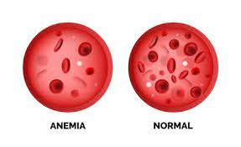
Model Building : Selecting the type of model that best suits your problem like Random Forests, Decision Tree, Navie bayes, K-nearest neighbors etc.
Training the Model: It involves feeding data to the model and adjusting its parameters to get the result.

Slide 9
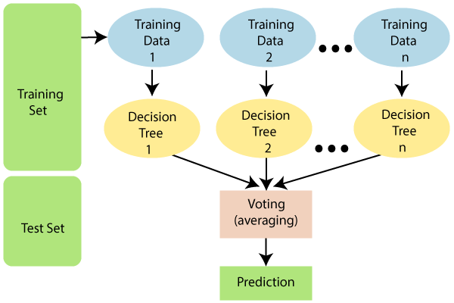
RANDOM FOREST
Random Forest is a popular machine learning algorithm that belongs to the supervised learning technique. It can be used for both Classification and Regression problems in ML.
Random Forest is a classifier that contains a number of decision trees on various subsets of the given dataset and takes the average to improve the predictive accuracy of that dataset.

Slide 10
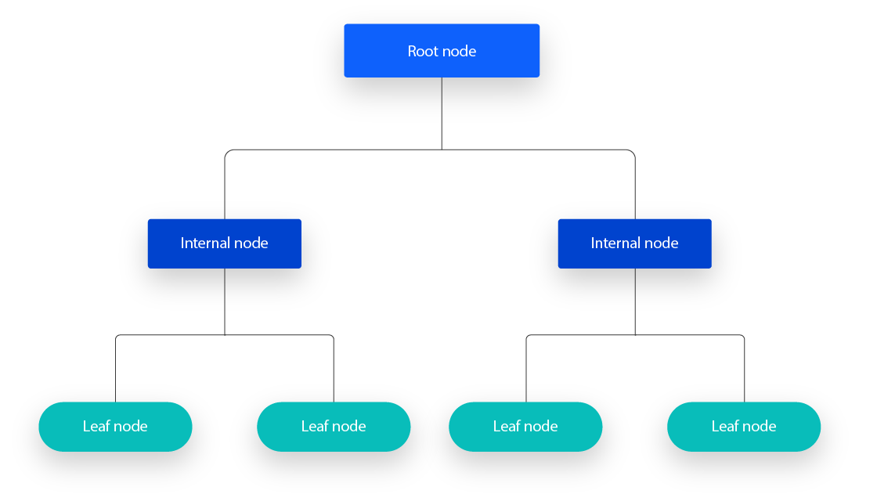
DECISION TREE
Decision Tree is a Supervised learning technique that can be used for both classification and Regression problems, but mostly it is preferred for solving Classification problems.
Decision tree is organized, with a root node, internal nodes, and leaf nodes.

Slide 11
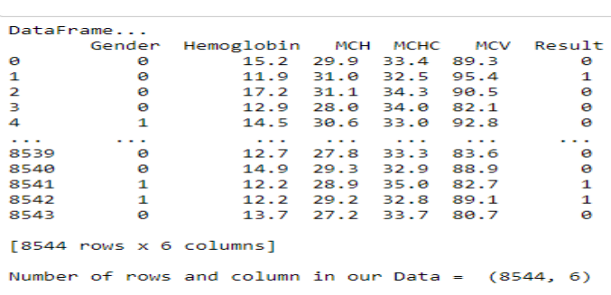

ANEMIA PREDICTION DATASETS

Slide 12

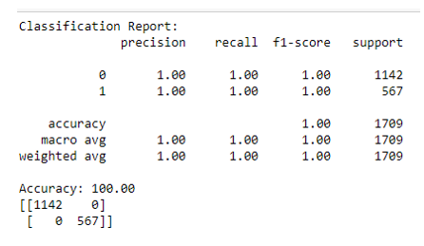
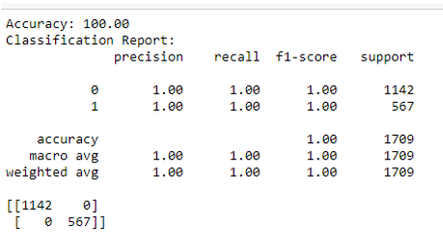
RESULTS
Result of Random Forest Result of Decision Tree

Slide 13
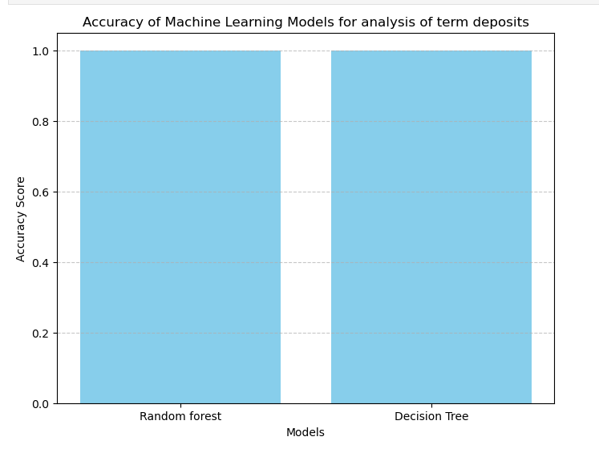

Slide 14
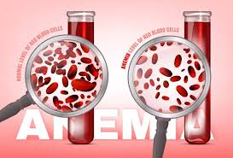
CONCLUSION
Anemia prediction can lessen the amount of manual work required for diagnosis.
Both models exhibited high accuracy, precision, recall, and F1-score, indicating their effectiveness in predicting anemia.
visualization of model performance through confusion matrices provided insights into the models' ability to correctly classify cases of anemia.
After testing two different algorithms, The Random Forest and Decision Tree both the algorithm give the 100% accuracy.

Slide 15
REFERENCES
[1]. Kawo, K.N., Asfaw, Z.G., Yohannes, N.: Multilevel analysis of determinants of anemia prevalence among children aged 6 59 months in Ethiopia: classical and Bayesian approaches. Anemia 2018 (2018).
[2]. Feusier, J.E.; Arunachalam, S.; Tashi, T.; Baker, M.J.; Van- Sant-Webb, C.; Ferdig, A.; Welm, B.E.; Rodriguez-Flores, J.L.; Ours, C.; Jorde, L.B.; et al. Large-scale Identification of Clonal Hematopoiesis and Mutations Recurrent in Blood Cancers. Blood Cancer Discov. 2021, 2, 226-237. [CrossRef]
[3].World Health Organization. Hemoglobin concentrations for the diagnosis of anemia and assessment of severity. No. WHO/NMH/NHD/MNM/11.1. World Health Organization, 2011.
[4].McLean E, Cogswell M, Egli I, Wojdyla D, De Benoist B. Worldwide prevalence of anemia, WHO vitamin and mineral nutrition information system, 1993-2005. Public health nutrition. 2009 Apr;12(4):444-54.

Slide 16
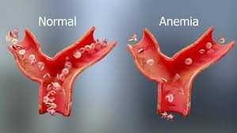
[5].Prevalence of Anemia in Women of Reproductive Age, Our World in Data. Available online: https://ourworldindata.org/grapher/prevalence-of-anemia-in-women-of-reproductive-age- aged-15-29 (accessed on 28 November 2022)
[6].Khan, Jahidur Rahman, et al. "Machine learning algorithms to predict the childhood anemia in Bangladesh." Journal of Data Science 17.1 (2019): 195-218.
[7].Obaidy, Midhin AL, et al. "Prevalence and Risk Factors of Anemia among Children Aged 5 months-12 years at Al Anbar Province." Mosul Journal of Nursing 9.1 (2021): 131-137.

Slide 17
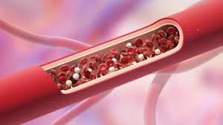
THANK YOU

